Slide 1
What 2 things are responsible for Genetic Drift?
Bottleneck Effect
Founder Effect

Slide 2
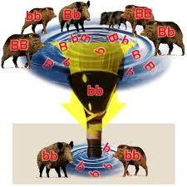
Bottleneck Effect
Decrease in numbers of organisms because of
  Natural disaster
  Predators
  Lack of resources (food, shelter, space)
Reduce genetic diversity
brooklyn.cuny.edu

Slide 3
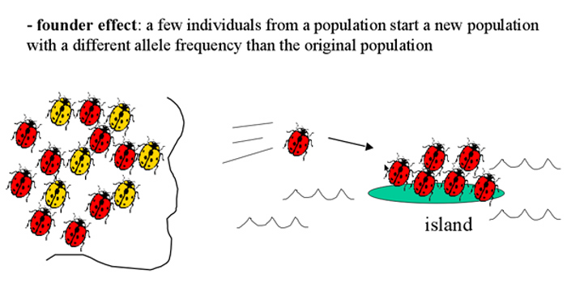
Founder Effect
biology200.gsu.edu

Slide 4
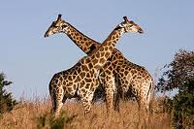
Isolating Mechanisms
Reproductive Isolation: en.wikipedia.org
  2 populations can no longer mate and produce viable offspring
  Ex: There are 6 species of giraffes because they do not mate with each other in the wild.

Slide 5
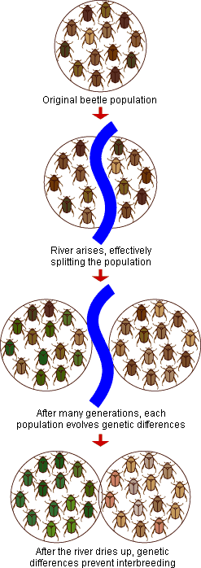
Geographic isolation: Populations are separated
by a physical barrier
  Ex: Squirrels on opposite
  sides of the Grand Canyon
evolution.berkeley.edu

Slide 6
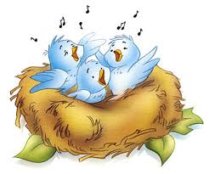
Behavioral Isolation:
  Populations that exhibit different behaviors will not mate.
  EX: different mating dances, different songs
Temporal Isolation: (time) aaps.k12.mi.us
  Populations reproduce at different times
  EX: reproduce during different seasons or times of day

